Slide 1

Analysis of Denver Crime Reports
Chris Richards
Regis University
MS in Data Science
Summer 2020

Slide 2



Project Introduction
Goal
Predict category of crime based on existing crime reports
Data Science Task
Model building with various classifiers
Analysis
Exploratory Data Analysis
Time-series analysis
Map geographic data

Slide 3





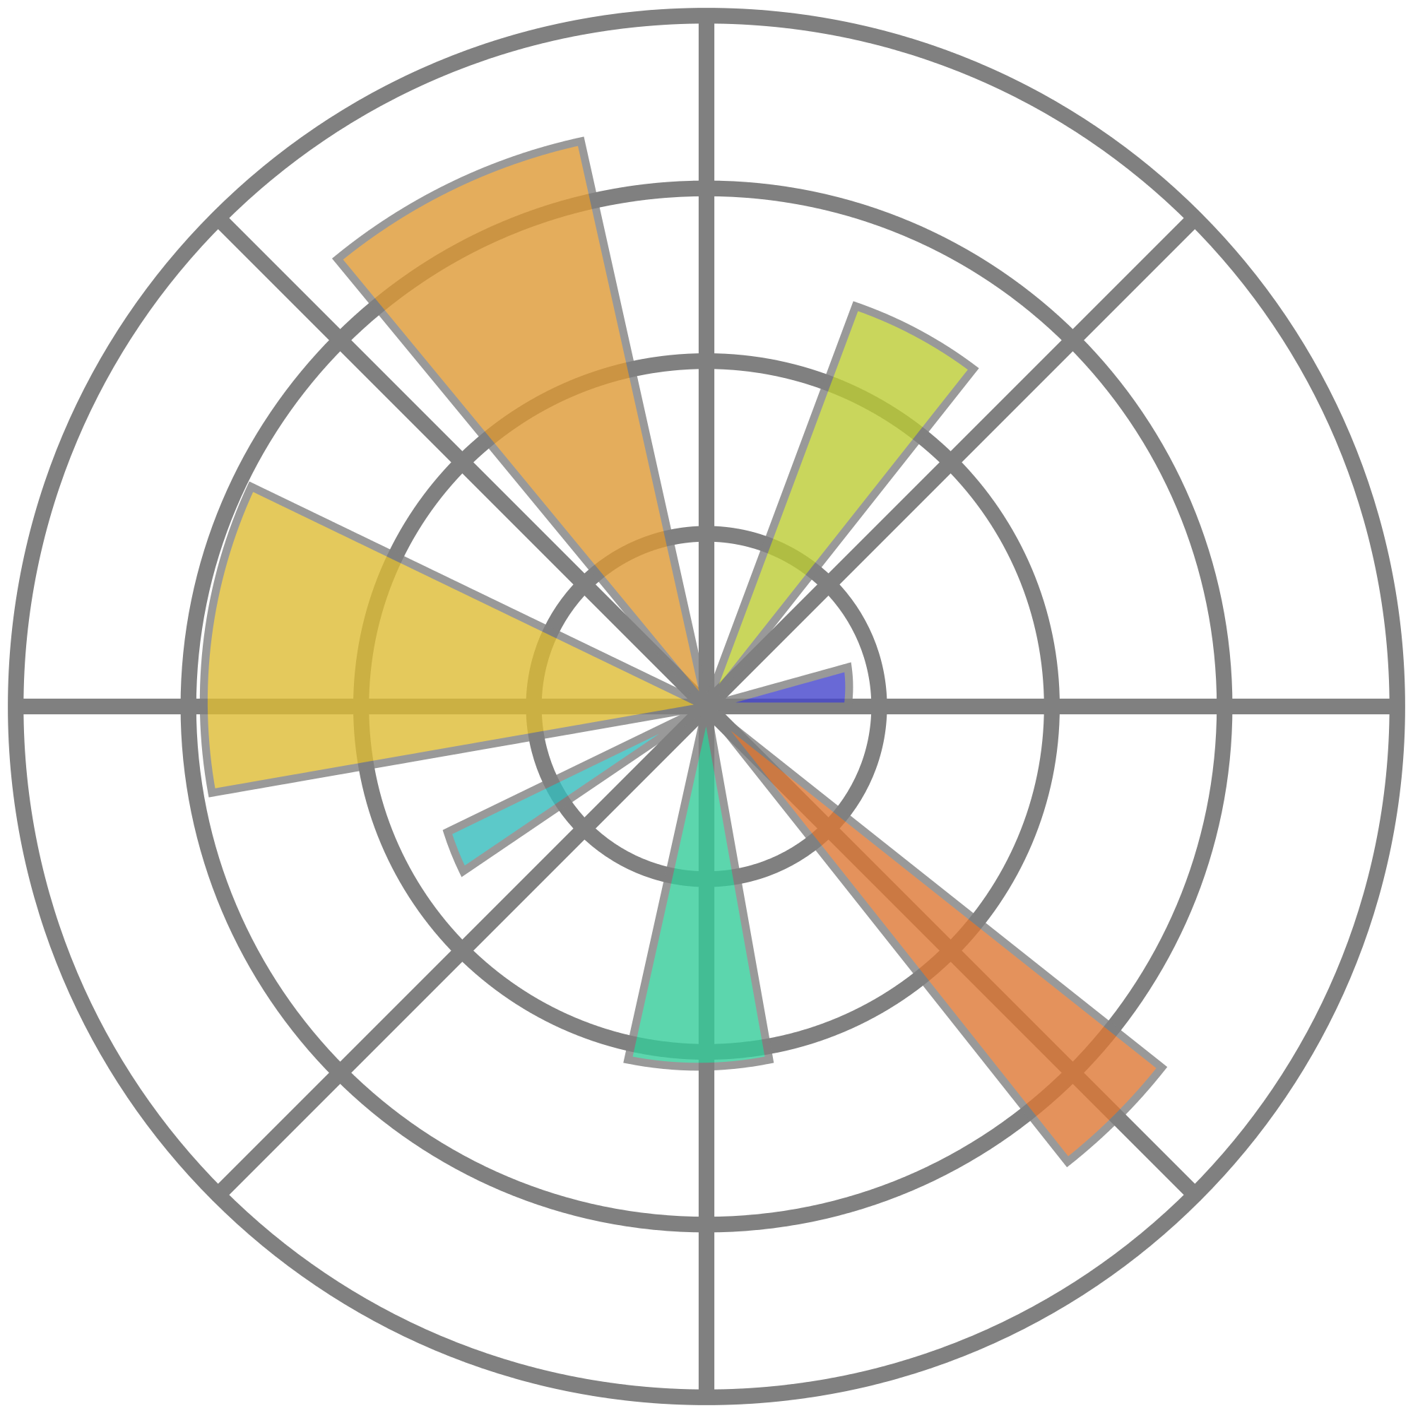

Project Introduction
Environment
Libraries
Anaconda
Python 3
Jupyter Notebooks
Pandas
Geopandas
Folium
SweetVIZ
Graphviz
Sci-kit Learn
XGBoost
Seaborn
Matplotlib

Slide 4



Data Overview
Crime Report Data
Police Precinct Data
Neighborhood Data

Slide 5
Data Overview
Crime Report Data
Police Precinct
Neighborhood
City and County of Denver’s official government website
https://www.denvergov.org/opendata/dataset/city-and-county-of-denver-crime
Time Span: January 2015 - July 2020 Observations: 497,912
Features: 19

Slide 6
Data Overview
Police Precinct Data
Neighborhood
City and County of Denver’s official government website
Observations: 23
Features: 14
Precinct location, type, hours of operation, etc

Slide 7
Data Overview
Crime Reports
Police Precincts
Neighborhood Data
City and County of Denver’s official government website
Data originally from the 2010 U.S. Census
Observations: 78
Features: 116
Observations correspond to each of Denver’s 78 neighborhoods.
Features consist of household demographic and socioeconomic attributes.

Slide 8
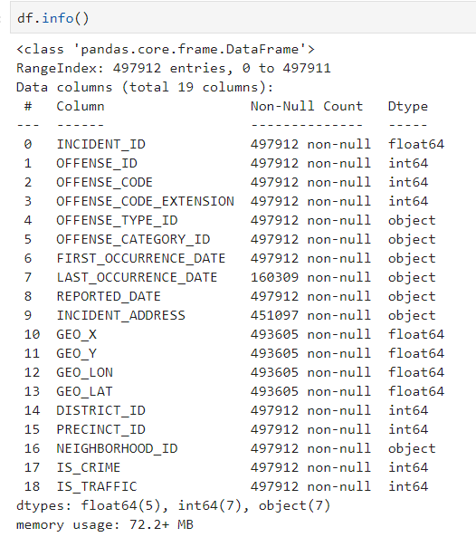
Data Cleaning
Extensive missing data
Address and location data redacted for sexual assault crimes
Address of nearest Police Precinct was converted to lat/lon and assigned as location of crime
“First Occurrence Date” of a crime contained default date of January 1st in many cases
“geo_x” and “geo_y” removed as lat/lon features already present
Report and crime identifiers were removed
Flags indicating traffic or crime related offenses removed
Neighborhood name re-formatted and standardized

Slide 9
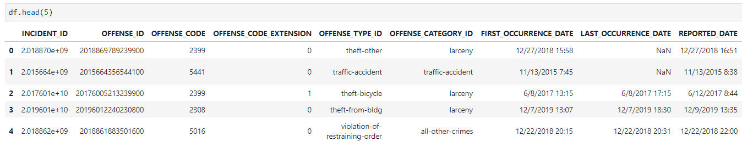

Data Cleaning
Dataframe…

Slide 10
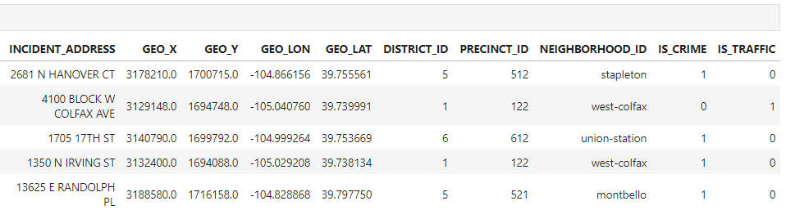
Data Cleaning
Dataframe, continued…

Slide 11
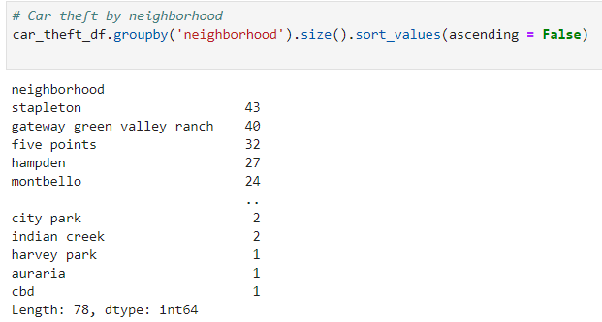
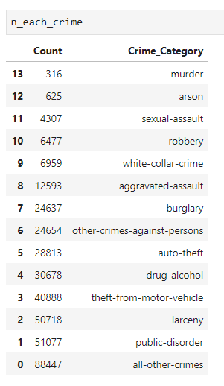
Exploratory Data Analysis (EDA)
Typical EDA activities were performed
Quantitative stats
Checking for null values and mitigating
Pairs plot for correlations
Visualizations
Incidence of crime, crime types, and seasonal variations of crime patterns
Number of crimes by police district and neighborhood
SweetVIZ for automated EDA
Comprehensive EDA report
Interactive HTML
SweetVIZ EDA Report

Slide 12
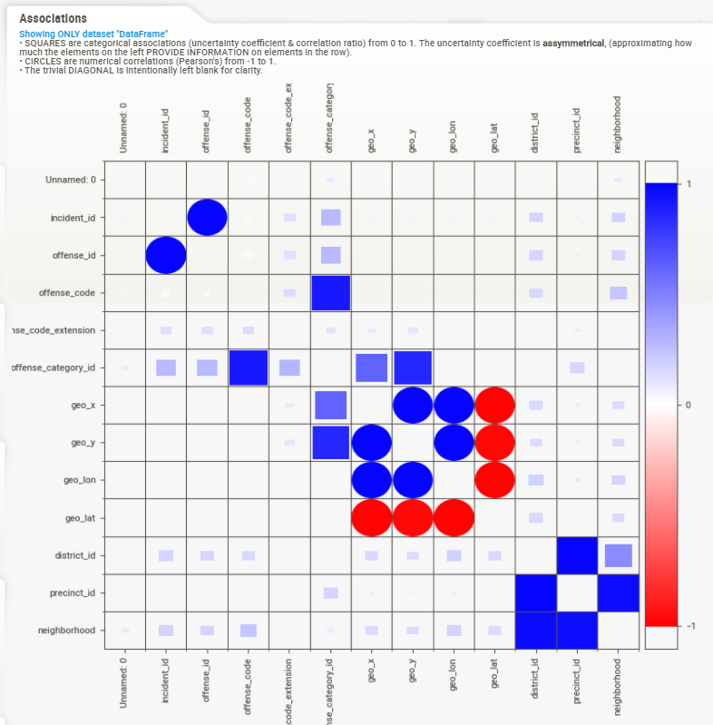

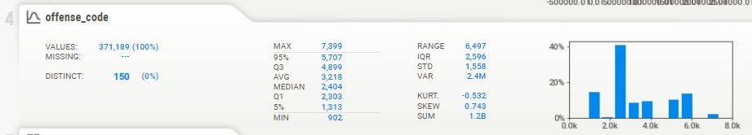
EDA SweetVIZ
Summary
Single Feature

Slide 13
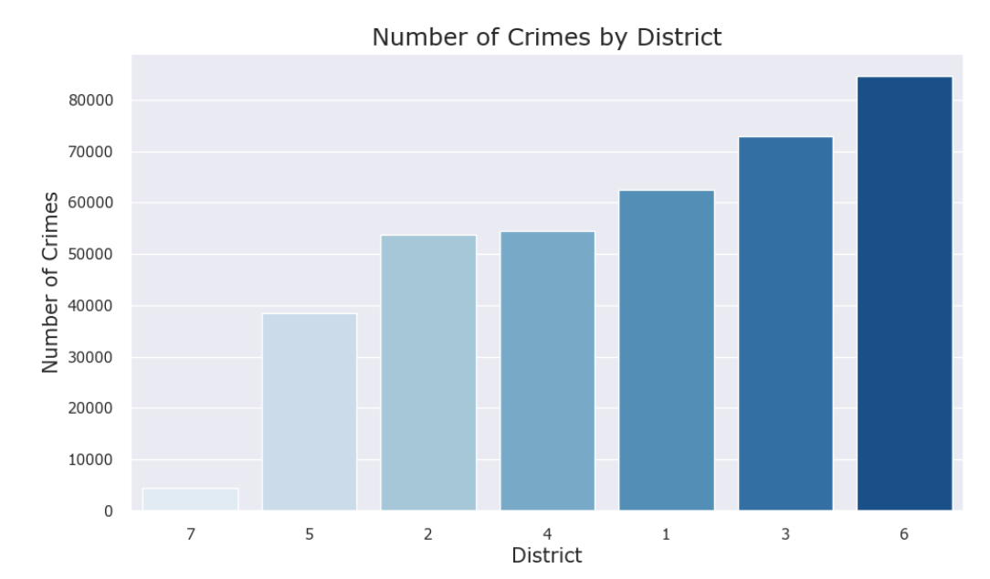
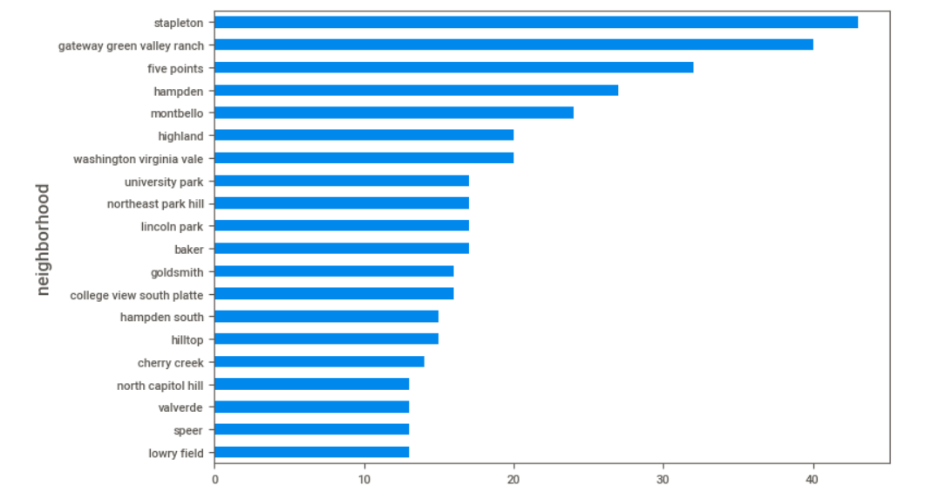
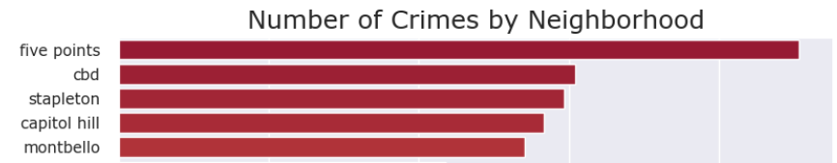
EDA Visualizations
Top 20 Car Theft Neighborhoods
Stapleton!
Five Points, CBD, Cap Hill
Top 5

Slide 14
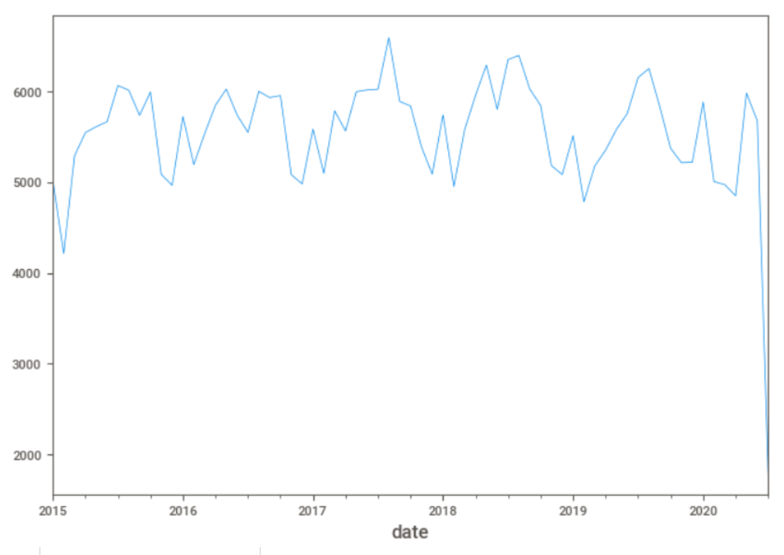
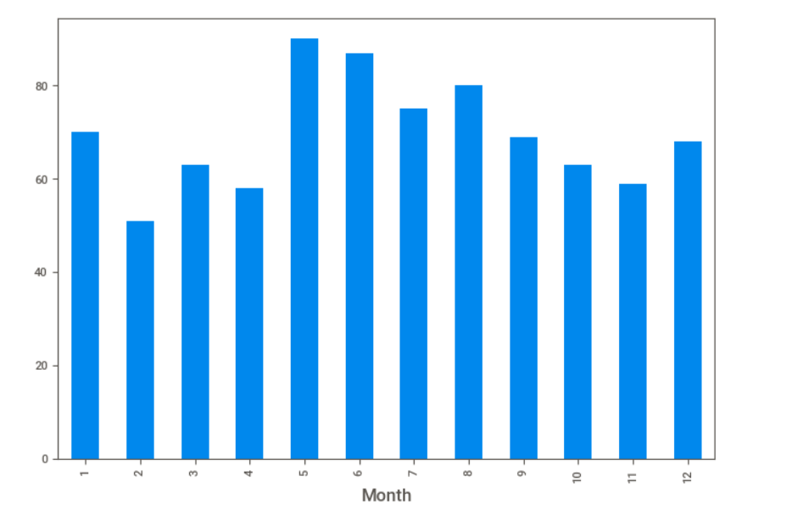
EDA Time-Series Analysis
Crimes by Year
Car Thefts by Month
Peaks in Summer
(Highest in mid ’17)
Most thefts in June

Slide 15

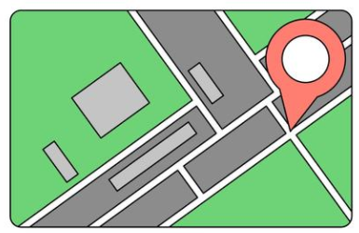
EDA Geographic Analysis
Latitude and longitude from the report used to locate the crime
Base Layer: Google maps
Data Layer: Crime Report data overlaid on the base layer
Shapefiles: Additional neighborhood data identified
Converted to geojson format for mapping the neighborhood boundaries
Library: Folium for map generation
Map 1 Crime frequency across Denver's neighborhoods
Choropleth
Map 2 Location of each crime report with a marker.
Additional information displayed on marker click
Folium

Slide 16
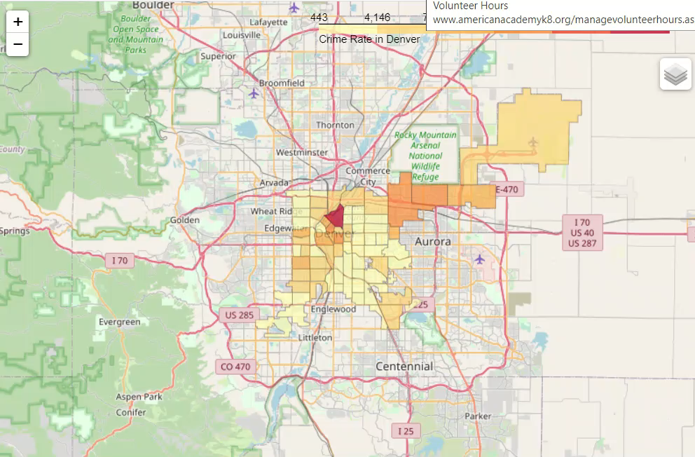
EDA Geographic Analysis
Choropleth Map of Crime by Neighborhood

Slide 17
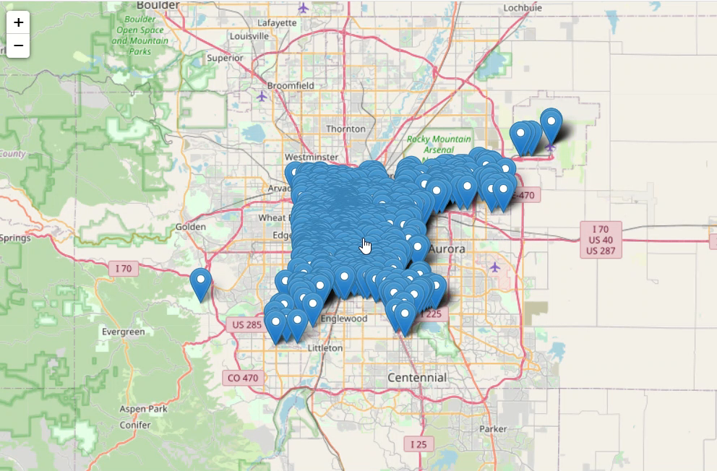
EDA Geographic Analysis
Map of Crime Reports (1000 Reports)

Slide 18
Predicting Crime Category Machine Learning Models
Support Vector Machine Classifier (SVC)
Categories
Aggravated Assault
Arson
Auto Theft
Burglary
Drug / Alcohol
Larceny
Murder
Other Crimes Against Persons
Public Disorder
Robbery
Sexual Assault
Theft from Motor Vehicle
Traffic Accident
White Collar Crime
All Other Crimes
Task: Train a model to perform multi-class classification of the target feature – Crime Category (15 categories)
Algorithm: SVC
Library: sci-kit learn
Train/Test: 70/30
Parameters: default w/RBF
Scoring Metric: Accuracy

Slide 19
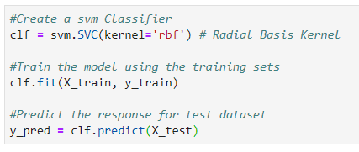

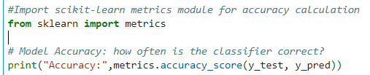


Predicting Crime Category Machine Learning Models
Support Vector Machine Classifier (SVC)
29.43%

Slide 20
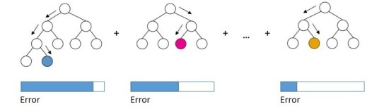


Predicting Crime Category Machine Learning Models
GridSearchCV
Task: Train a model to perform multi-class classification of the target feature – Crime Category (15 categories)
Algorithm: GridSearchCV with XGBoost classifier
Library: sci-kit learn
Train/Test: Cross-fold validation / k=5
Parameters: user defined collection
Scoring Metric: Accuracy
Boosted Decision Trees
1
2
…

Slide 21
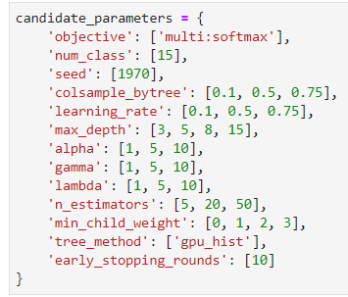
Predicting Crime Category Machine Learning Models
GridSearchCV

Slide 22
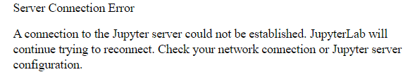
Predicting Crime Category Machine Learning Models
GridSearchCV
Environment Failures
Multiple CRITICAL ERRORS prevented model building when using the full data set
BrokenProcessPool: A task has failed to un-serialize. Please ensure that the arguments of the function are all picklable.
Windows 10 Failures
WinError -529697949] Windows Error 0xe06d7363

Slide 23
Predicting Crime Category Machine Learning Models
GridSearchCV
SOLUTIONS
Removed Neighborhood / Census features
Sampled data looking for largest number of rows that would process
Implemented additional parameters
Early Stopping
GPU Processing
Successfully processed 1% of the data

Slide 24
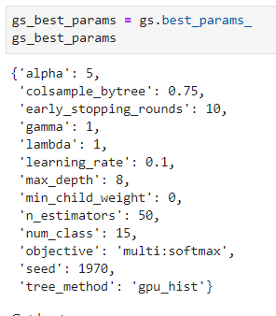
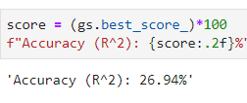
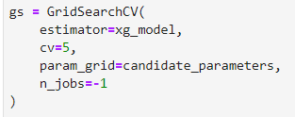
Predicting Crime Category Machine Learning Models
GridSearchCV
Best Estimator
Score

Slide 25
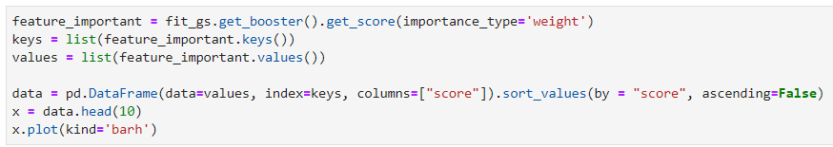
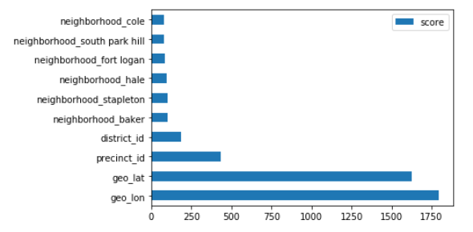
Predicting Crime Category Machine Learning Models
GridSearchCV
Feature Importance
Latitude and Longitude
MOST IMPORTANT!

Slide 26
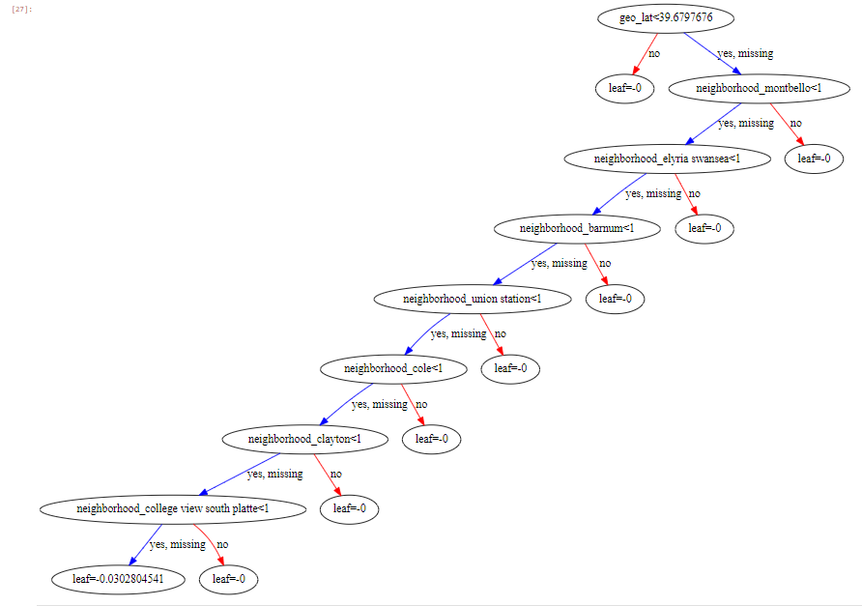
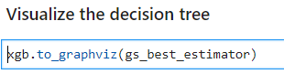
Predicting Crime Category Machine Learning Models
GridSearchCV

Slide 27
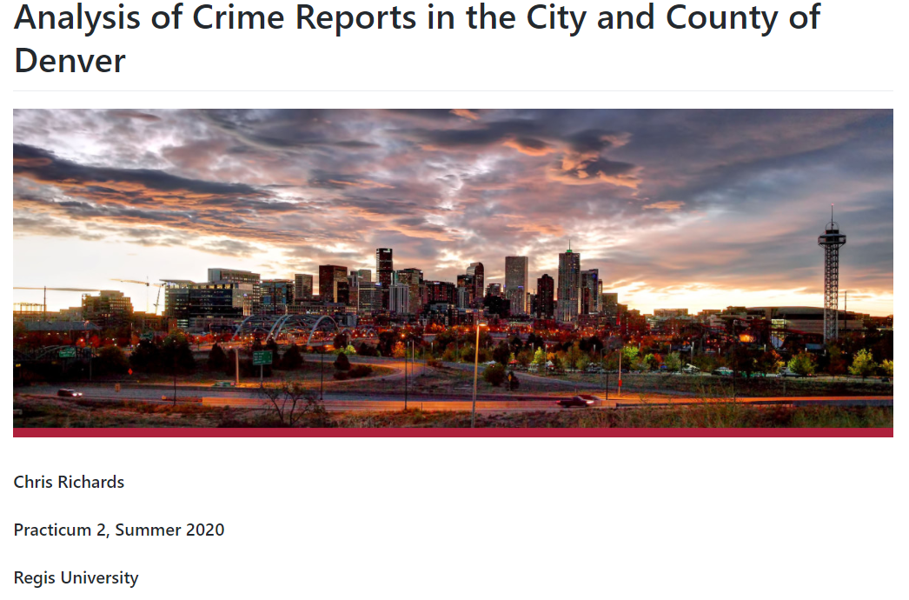
Github
Link to Project Repository: https://github.com/crichards1179/Predicting-Crime-Category-from-Denver-Crime-Reports

Slide 28
Conclusion
Gained experience with geodata and time-series data
Cleaned and explored large data sets
Aggregated data from multiple sources
Hands-on work with different classifiers, including ensemble learning algorithm
Used GridsearchCV for hyperparameter tuning and cross-validation
Future project work to improve model performance
» reintroduce census data, reassess GridsearchCV parameters, implement additional feature importance steps, implement additional classification algorithms

Slide 29

Conclusion
Thank You

